Slide 1


Phenological plasticity:
Shifting growth and developmental phases of North American tree species in response to environmental stressors
Frederik Baumgarten, University of British Columbia

Slide 2
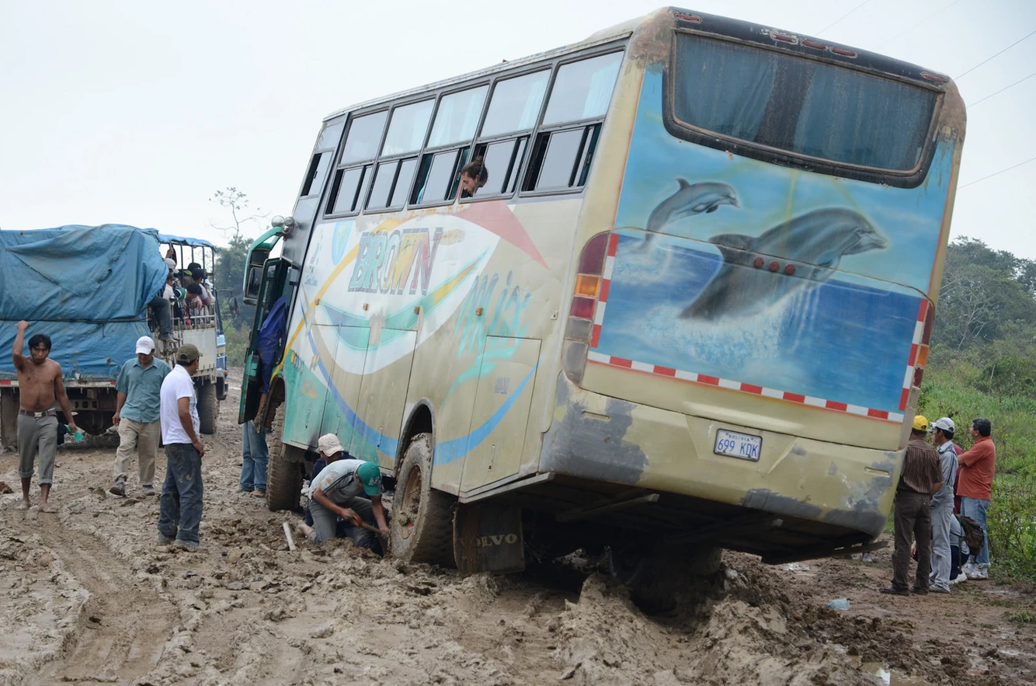
Notes:
I want to start with a story that inspired this project. I love public transport.

Slide 3
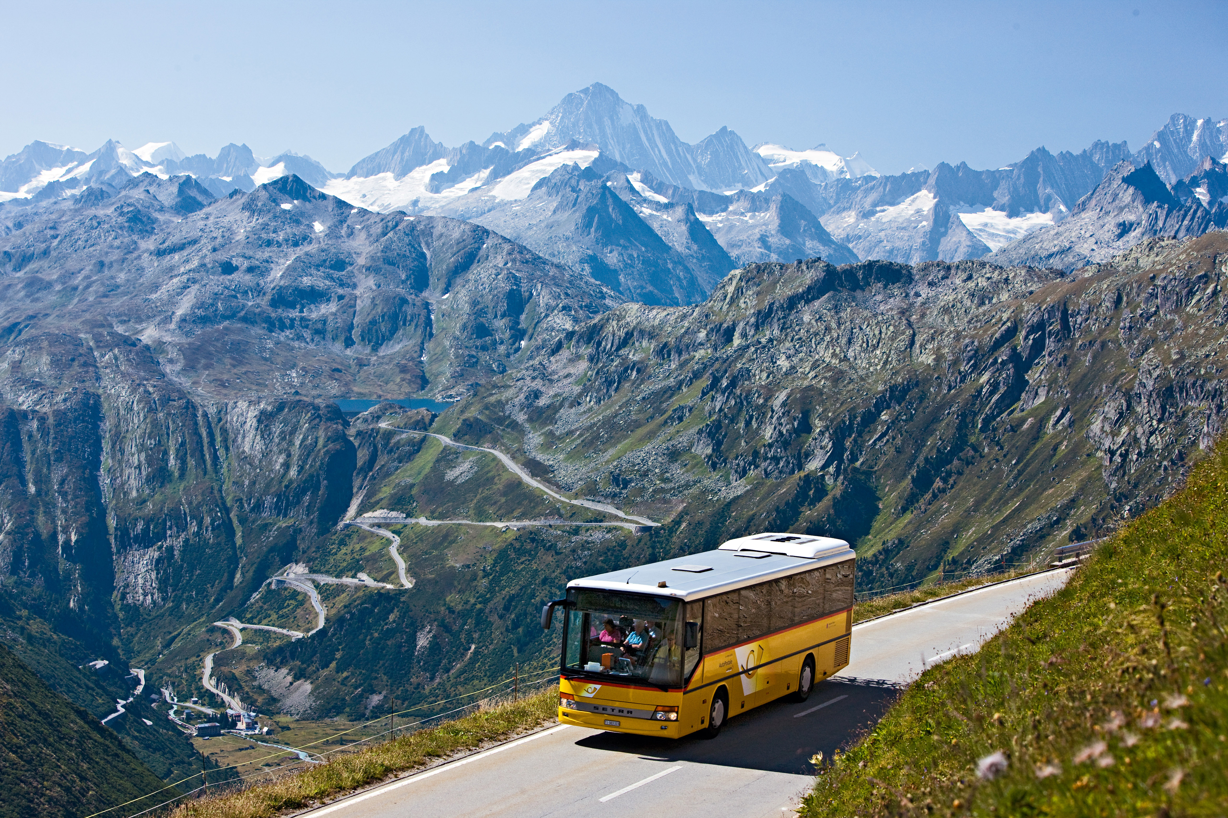

Slide 4
Swiss transport:
very punctual
Conservative (fixed route and stops)
Bolivian transport:
high uncertainty
Flexible (improvised route and stops)

Slide 5


Jan
Feb
Mar
Apr
May
Jun
Jul
Aug
Sep
Oct
Nov
Dec
Potential growing season
Notes:
Bus stops at different pheno stages and we can formulate the following hypothesis

Slide 6
Jan
Feb
Mar
Apr
May
Jun
Jul
Aug
Sep
Oct
Nov
Dec
control
Growth rate
Potential growing season

Slide 7
Stressor (2 weeks drought)
Jan
Feb
Mar
Apr
May
Jun
Jul
Aug
Sep
Oct
Nov
Dec
control
Growth rate
Potential growing season

Slide 8
Stressor (2 weeks drought)
Jan
Feb
Mar
Apr
May
Jun
Jul
Aug
Sep
Oct
Nov
Dec
control
conservative (Swiss style)
Growth rate
Potential growing season

Slide 9
Stressor (2 weeks drought)
Jan
Feb
Mar
Apr
May
Jun
Jul
Aug
Sep
Oct
Nov
Dec
control
conservative (Swiss style)
Growth rate
flexible (Bolivian style)
Potential growing season

Slide 10
The “Window(s) of Opportunity”
Two components:
External (environmental constraints)
Internal (genetic programing of a plant)
Notes:
Because most of you have an engineering background and might be more into solving technical problems I would like to give you some background on why we choose to work with your dendrometers…

Slide 11
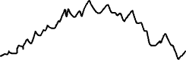
1. filter: Temperature
too warm
(enzyme denaturation)
~40˚C
Temperature
(°C)
optimum
too cold
~5˚C
(slow metabolism)
Growth rate
Jan
Feb
Mar
Apr
May
Jun
Jul
Aug
Sep
Oct
Nov
Dec
External factors (climatic envelope)
2. filter: Soil moisture
Year
Soil water potential
(MPa)
too dry
low cell turgor
(limited cell expansion)
hydraulic failure
Growth rate
3. filter: Dormancy cycle
Dormancy depth
determinate
dormant
indeterminate
4. filter: Investment strategy
Reproduction
Growth
Storage
Growth strategy
Carbon allocation
determinate
indeterminate
-> Realized growth
determinate
Growth rate
indeterminate
Jan
Feb
Mar
Apr
May
Jun
Jul
Aug
Sep
Oct
Nov
Dec
Year

Slide 12
1. filter: Temperature
too warm
(enzyme denaturation)
~40˚C
Temperature
(°C)
optimum
too cold
~5˚C
(slow metabolism)
Growth rate
Jan
Feb
Mar
Apr
May
Jun
Jul
Aug
Sep
Oct
Nov
Dec
External factors (climatic envelope)
2. filter: Soil moisture
Year
Soil water potential
(MPa)
too dry
low cell turgor
(limited cell expansion)
hydraulic failure
Growth rate
3. filter: Dormancy cycle
Dormancy depth
determinate
dormant
indeterminate
4. filter: Investment strategy
Reproduction
Growth
Storage
Growth strategy
Carbon allocation
determinate
indeterminate
-> Realized growth
determinate
Growth rate
indeterminate
Jan
Feb
Mar
Apr
May
Jun
Jul
Aug
Sep
Oct
Nov
Dec
Year

Slide 13
1. filter: Temperature
too warm
(enzyme denaturation)
~40˚C
Temperature
(°C)
optimum
too cold
~5˚C
(slow metabolism)
Growth rate
2. filter: Soil moisture
External factors (climatic envelope)
Soil water potential
(MPa)
too dry
low cell turgor
(limited cell expansion)
hydraulic failure
Growth rate
Jan
Feb
Mar
Apr
May
Jun
Jul
Aug
Sep
Oct
Nov
Dec
3. filter: Dormancy cycle
Year
Dormancy depth
determinate
dormant
indeterminate
4. filter: Investment strategy
Reproduction
Growth
Storage
Growth strategy
Carbon allocation
determinate
indeterminate
-> Realized growth
determinate
Growth rate
indeterminate
Jan
Feb
Mar
Apr
May
Jun
Jul
Aug
Sep
Oct
Nov
Dec
Year

Slide 14
1. filter: Temperature
too warm
(enzyme denaturation)
~40˚C
Temperature
(°C)
optimum
too cold
~5˚C
(slow metabolism)
Growth rate
2. filter: Soil moisture
External factors (climatic envelope)
Soil water potential
(MPa)
too dry
low cell turgor
(limited cell expansion)
hydraulic failure
Growth rate
Jan
Feb
Mar
Apr
May
Jun
Jul
Aug
Sep
Oct
Nov
Dec
3. filter: Dormancy cycle
Year
Dormancy depth
determinate
dormant
indeterminate
4. filter: Investment strategy
Reproduction
Growth
Storage
Growth strategy
Carbon allocation
determinate
indeterminate
-> Realized growth
determinate
Growth rate
indeterminate
Jan
Feb
Mar
Apr
May
Jun
Jul
Aug
Sep
Oct
Nov
Dec
Year

Slide 15
1. filter: Temperature
too warm
(enzyme denaturation)
~40˚C
Temperature
(°C)
optimum
too cold
~5˚C
(slow metabolism)
Growth rate
2. filter: Soil moisture
External factors (climatic envelope)
Soil water potential
(MPa)
too dry
low cell turgor
(limited cell expansion)
hydraulic failure
Growth rate
3. filter: Dormancy cycle
Dormancy depth
determinate
dormant
indeterminate
4. filter: Investment strategy
Reproduction
Internal factors (life history/phenology)
Jan
Feb
Mar
Apr
May
Jun
Jul
Aug
Sep
Oct
Nov
Dec
Growth
Year
Storage
Growth strategy
Carbon allocation
determinate
indeterminate
-> Realized growth
determinate
Growth rate
indeterminate
Jan
Feb
Mar
Apr
May
Jun
Jul
Aug
Sep
Oct
Nov
Dec
Year

Slide 16
1. filter: Temperature
too warm
(enzyme denaturation)
~40˚C
Temperature
(°C)
optimum
too cold
~5˚C
(slow metabolism)
Growth rate
2. filter: Soil moisture
External factors (climatic envelope)
Soil water potential
(MPa)
too dry
low cell turgor
(limited cell expansion)
hydraulic failure
Growth rate
3. filter: Dormancy cycle
Dormancy depth
determinate
dormant
indeterminate
4. filter: Investment strategy
Reproduction
Internal factors (life history/phenology)
Growth
Storage
Growth strategy
Carbon allocation
determinate
indeterminate
Jan
Feb
Mar
Apr
May
Jun
Jul
Aug
Sep
Oct
Nov
Dec
-> Realized growth
Year
determinate
Growth rate
indeterminate
Jan
Feb
Mar
Apr
May
Jun
Jul
Aug
Sep
Oct
Nov
Dec
Year

Slide 17
1. filter: Temperature
too warm
(enzyme denaturation)
~40˚C
Temperature
(°C)
optimum
too cold
~5˚C
(slow metabolism)
Growth rate
2. filter: Soil moisture
External factors (climatic envelope)
Soil water potential
(MPa)
too dry
low cell turgor
(limited cell expansion)
hydraulic failure
Growth rate
3. filter: Dormancy cycle
Dormancy depth
determinate
dormant
indeterminate
4. filter: Investment strategy
Reproduction
Internal factors (life history/phenology)
Growth
Storage
Growth strategy
Carbon allocation
determinate
indeterminate
Jan
Feb
Mar
Apr
May
Jun
Jul
Aug
Sep
Oct
Nov
Dec
-> Realized growth
Year
determinate
Growth rate
indeterminate
Jan
Feb
Mar
Apr
May
Jun
Jul
Aug
Sep
Oct
Nov
Dec
Year

Slide 18
1. filter: Temperature
too warm
(enzyme denaturation)
~40˚C
Temperature
(°C)
optimum
too cold
~5˚C
(slow metabolism)
Growth rate
2. filter: Soil moisture
External factors (climatic envelope)
Soil water potential
(MPa)
too dry
low cell turgor
(limited cell expansion)
hydraulic failure
Growth rate
3. filter: Dormancy cycle
Dormancy depth
determinate
dormant
indeterminate
4. filter: Investment strategy
Reproduction
Internal factors (life history/phenology)
Growth
Storage
Growth strategy
Carbon allocation
determinate
indeterminate
-> Realized growth
determinate
Growth rate
indeterminate
Jan
Feb
Mar
Apr
May
Jun
Jul
Aug
Sep
Oct
Nov
Dec
Year

Slide 19
Research Questions
How plastic are trees in rearranging their development and growth over the growing season if interrupted by a stressor?
What is the growth period under ideal conditions?
Are early successional/pioneer species more plastic?

Slide 20
Study Design

Slide 21
Study Design
6 species:
Prunus virginiana
Betula papyrifera
Acer macrophyllum
Quercus garryana
Pinus contorta
Sequoia sempervirens

Slide 22
Study Design
6 species:
Prunus virginiana
Betula papyrifera
Acer macrophyllum
Quercus garryana
Pinus contorta
Sequoia sempervirens
Drought events -> sink limitation
Defoliation events -> source limitation

Slide 23
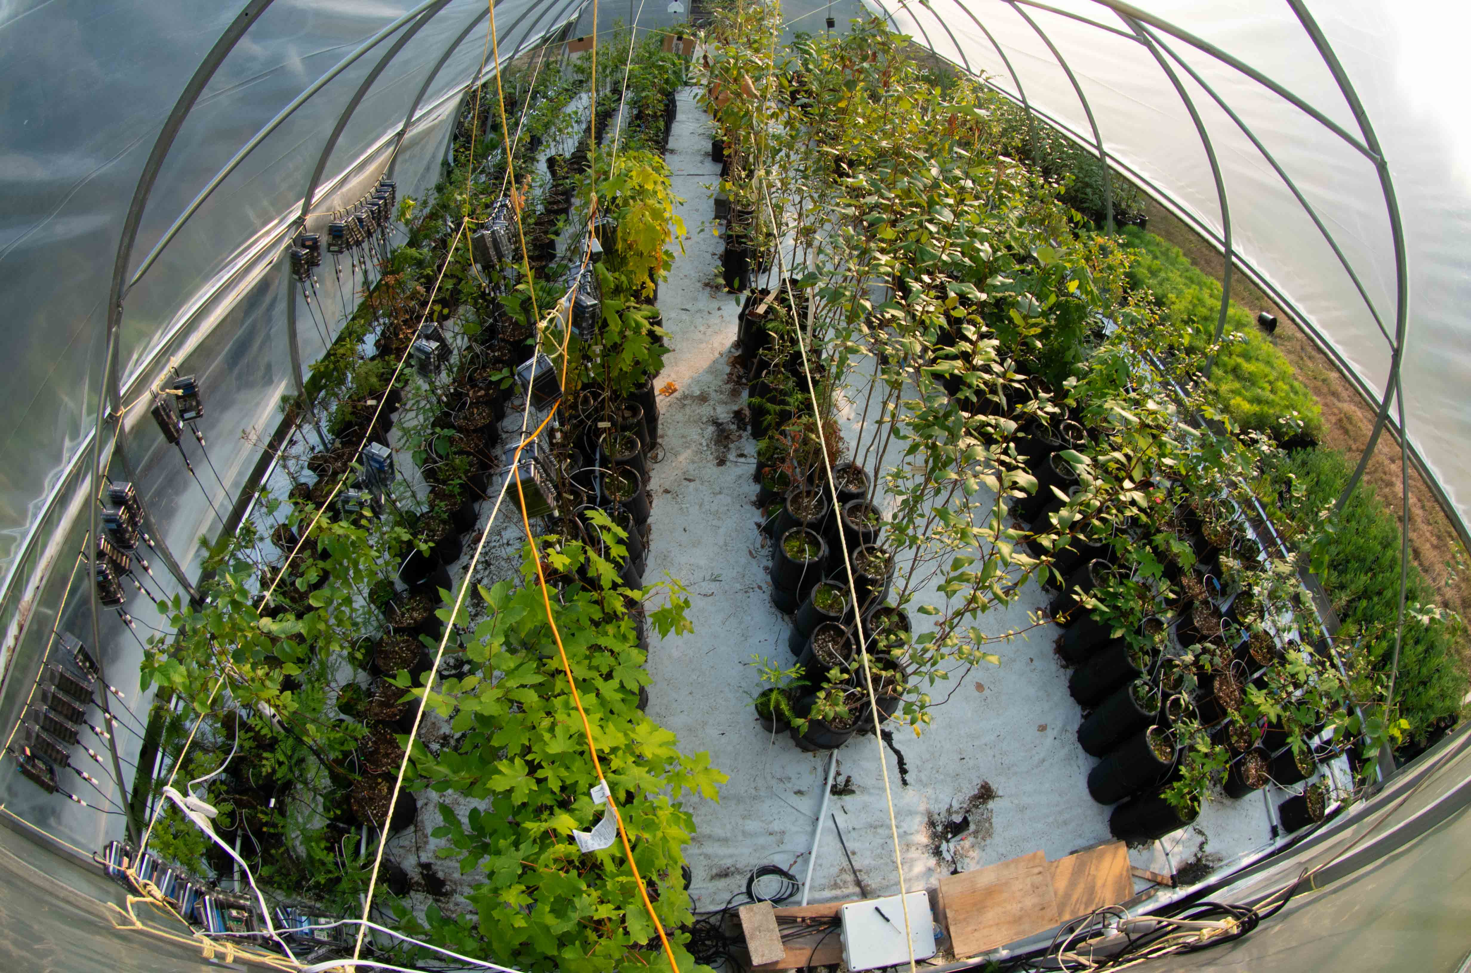
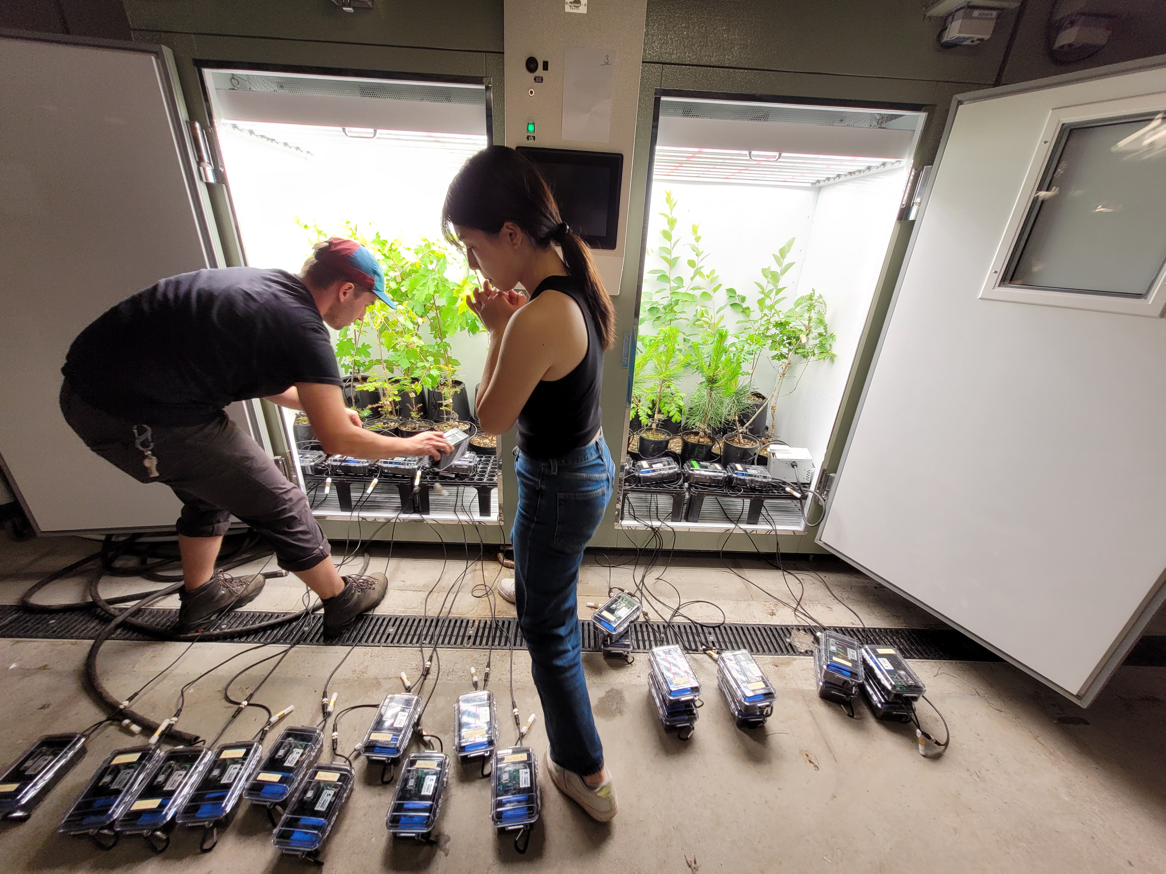
Experimental Setup
Polytunnel
Climate chambers
Notes:
And to sense this crucial timepoint trees have only two indicators: Temperature and PP
But altough there are only these 2 main drivers it is rahter complex to understand and predict this phenological event.
After the growing seson a trees undergoes different stages
These three main drivers may interact also in time and surely across species
After release of Endodormancy, Photoperiod and Forcing temperature are the main drivers for leaf-out
Cold temperatures (Chilling)
Warm temperature (Forcing)

Slide 24
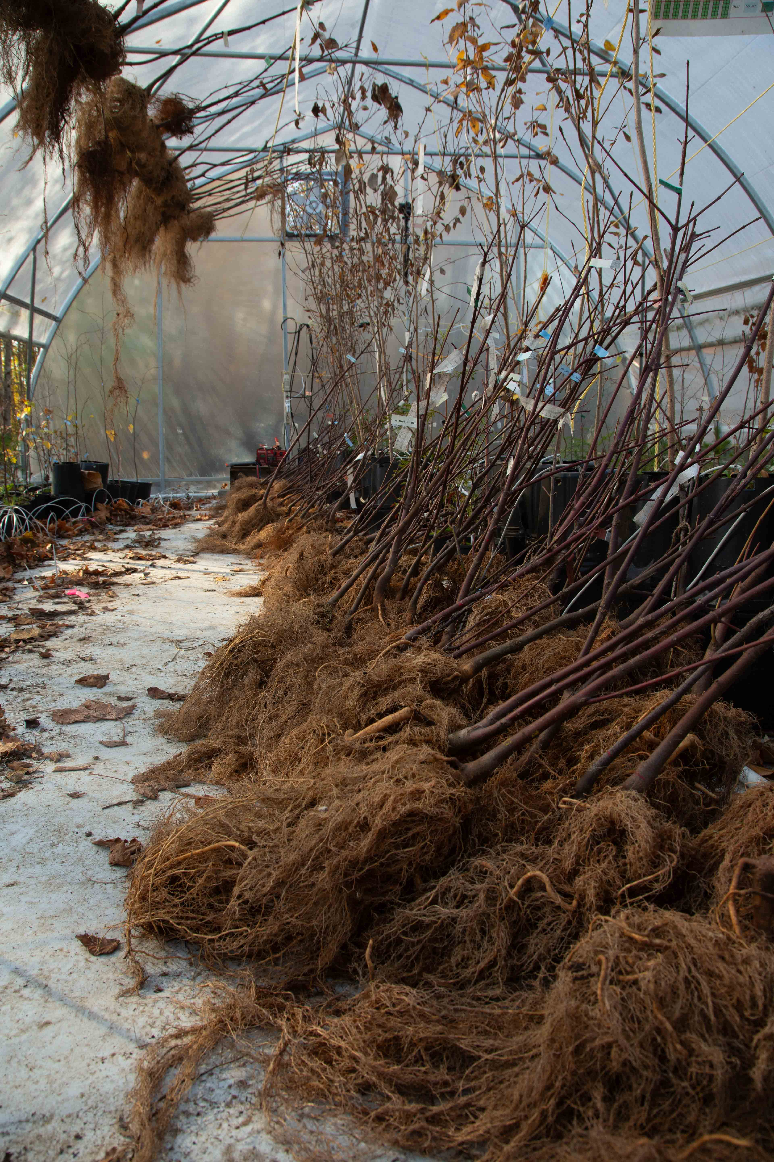
First Glimpse on the data
Notes:
Similar for roots and new shoots
Growth seems to be highly dependent on new assimilates. Defoliation has overall bigger impact than drought. Which is surprising to me.

Slide 25
First Glimpse on the data
Late drought impact for species exhibiting a late growing strategy (indeterminate growers)
Notes:
Similar for roots and new shoots
Growth seems to be highly dependent on new assimilates. Defoliation has overall bigger impact than drought. Which is surprising to me.
How is the increment?

Slide 26
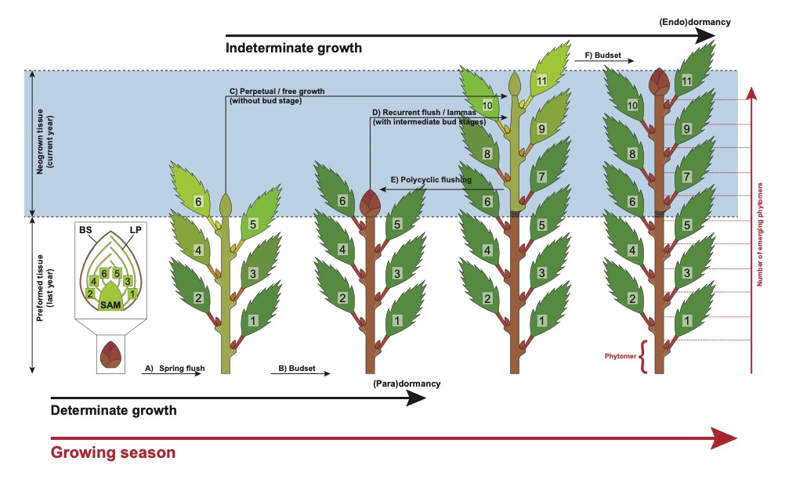

Degree of Determinism
Betula papyrifera

Slide 27
Summary
Growth is much dependent on fresh assimilates (source limitation).
Degree of determinism might be an important trait shaping stress responses:
Indeterminate species respond to the current conditions. Immediate impact of drought but potential gains with extended growing season
Determinate species are less impacted by drought events than indeterminate species. But what about next year?

Slide 28
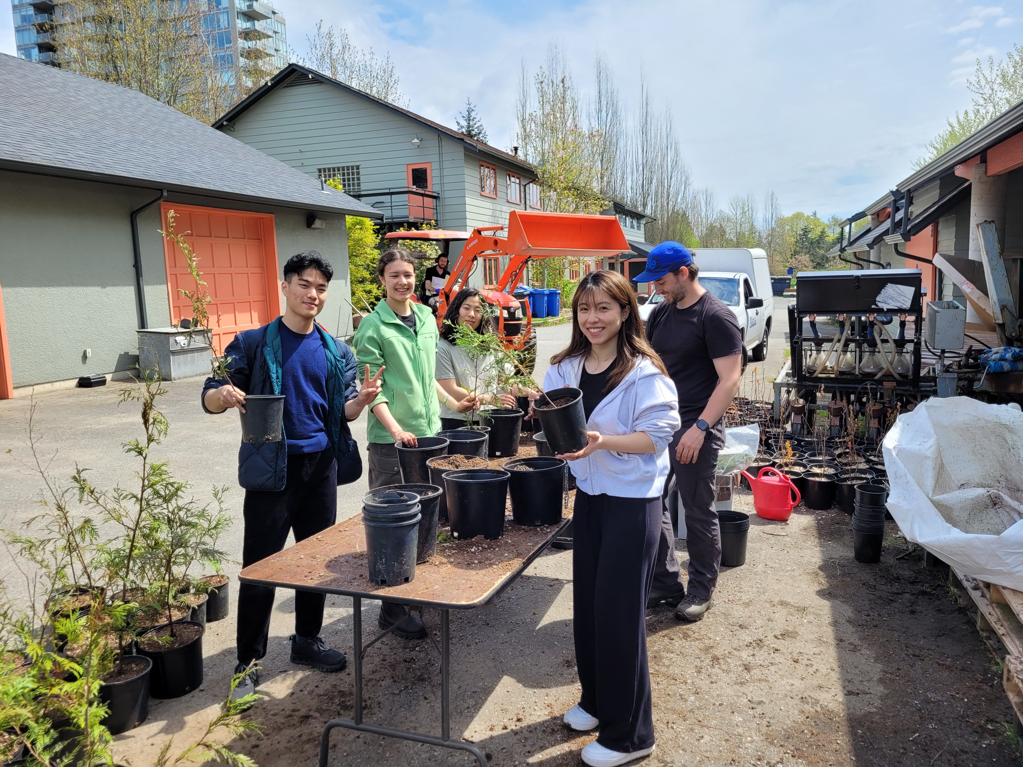
Thanks to…
Temporal ecology Lab, UBC
Fotos Lizzie, Deirdre?
Contact:
frederik.baumgarten@ubc.ca
Notes:
Perhaps add it to the slide with the many roots?

Slide 29
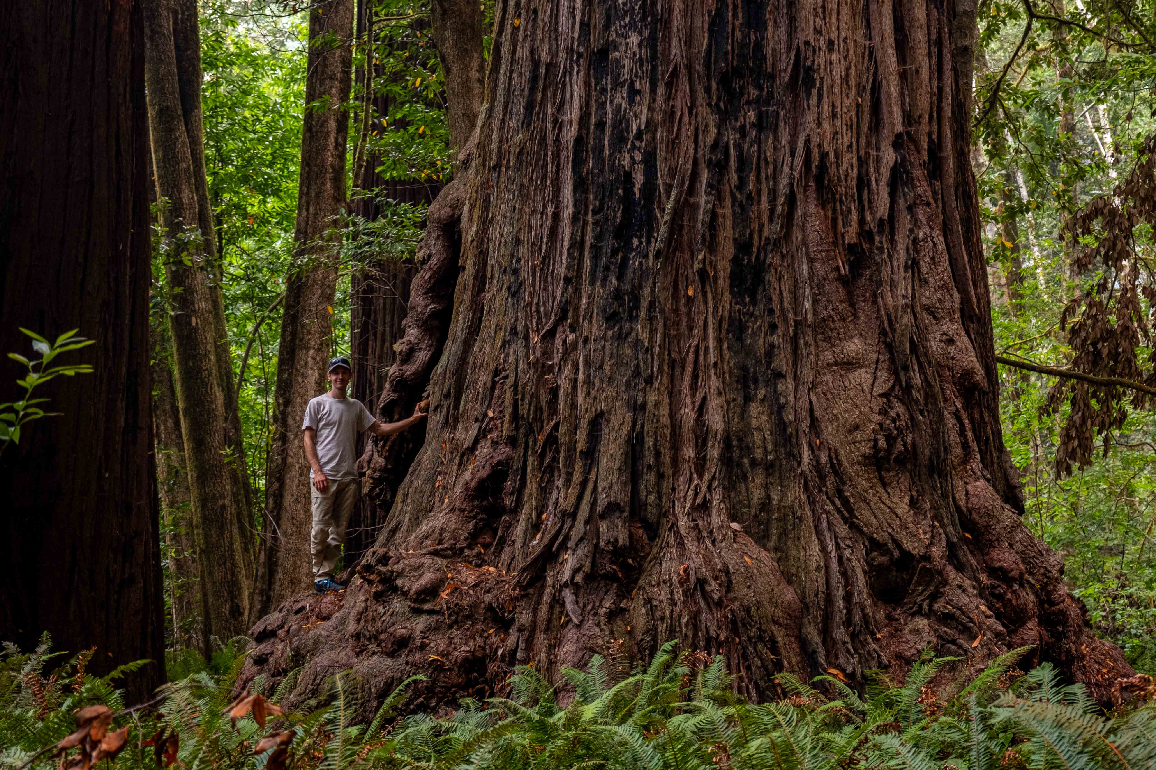
Phenological Cycle of Trees
Questions?
frederik.baumgarten@ubc.ca
Notes:
Aim:
Good to connect

Slide 31
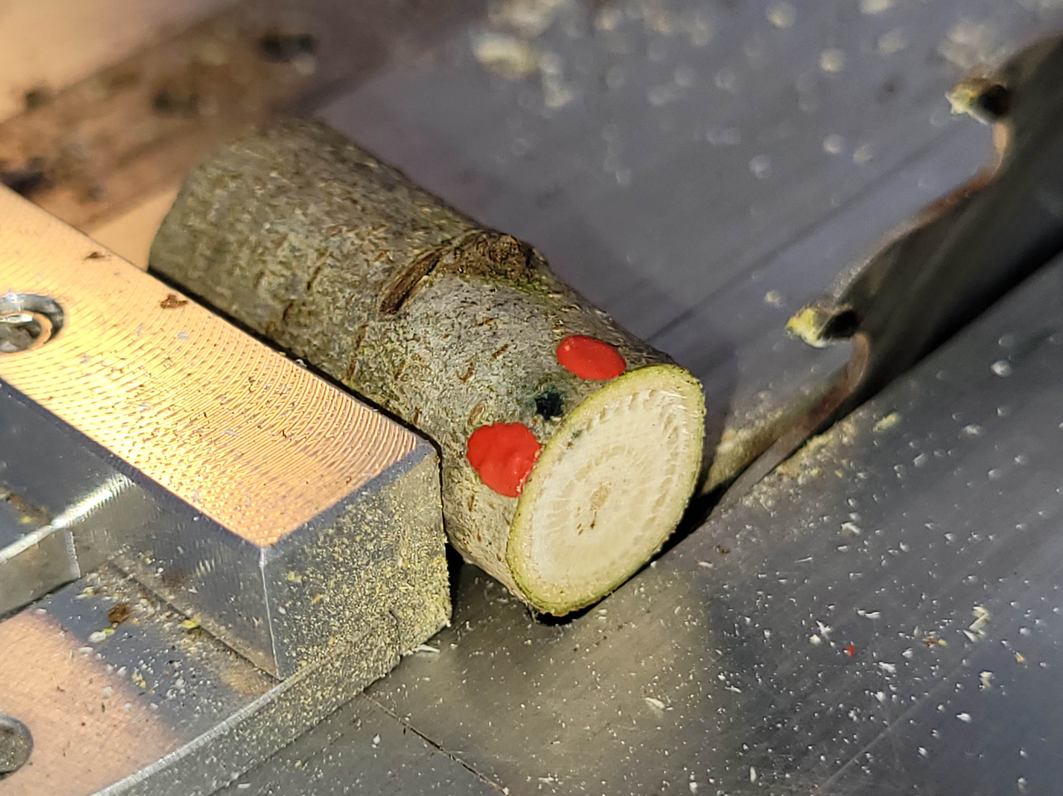
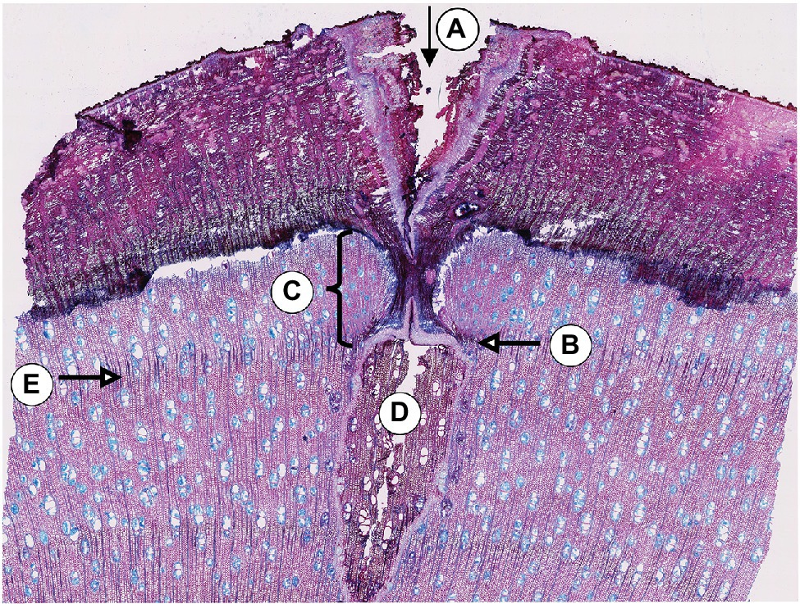
Next at WSL…
Gärtner & Farahat, 2021

Slide 32

Ambient conditions at Totem Fields
Treatments
Drought (2 weeks, 30/20°C day/night,
ambient photoperiod, climate chamber)
Defoliation (partly/full clipping, burning with a heat gun to simulate spring frosts, insect outbreak or heat waves)
Temperature
Growing season extension (induced by c. 2 weeks of warming, Greenhouse)
Heat wave (induced by c. 2 weeks of 35°C, climate chamber)
Jan
Feb
Mar
Apr
May
Jun
Jul
Aug
Sep
Oct
Nov
Dec
2023
(Some) research questions:
How flexible are species in shifting their phenological sequence and growth within the growing season?
When is growth affected most if interrupted by drought?
How much does an extended growing season translate into increased biomass production?
Measurements/Observations
Phenology:
Leaf-out
bud set
senescence
Growth:
radial (magnetic stem dendrometers)
apical shoot elongation
Total biomass increment
Wood anatomy:
number of cells produced after/during treatment
Cell wall characteristics
8 species (4 congeneric pairs that differ in drought tolerance):
Pinus contorta vs. strobus
Quercus macrocarpa vs. rubra
Acer macrophyllum vs. negudo
Sequoia sempervirens vs. Sequoiadendron giganteum

Slide 33
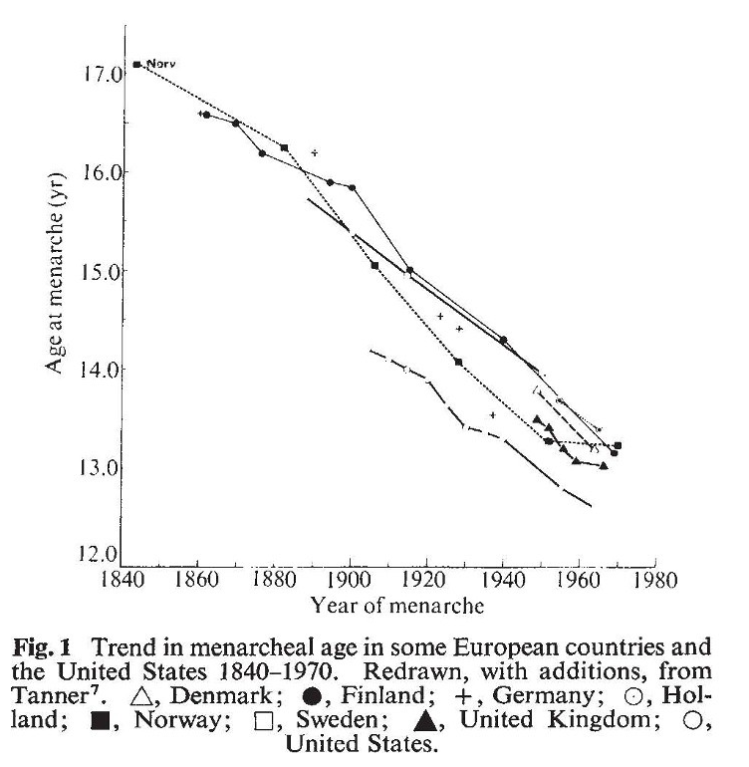

Phänologie?
Tanner (1973), Nature
Notes:
How women got their curves

Slide 34
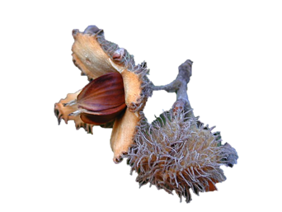
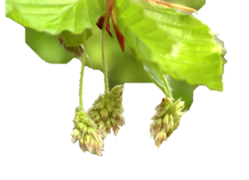
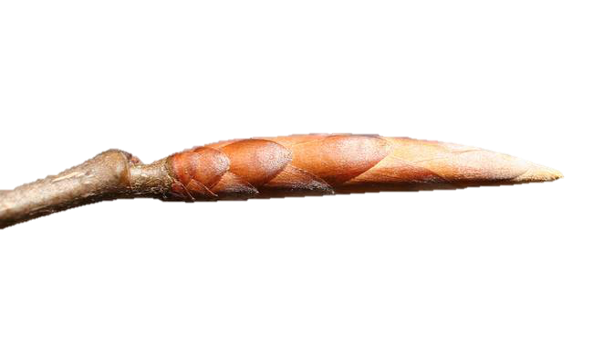

Phenological Cycle of Trees
time
Leaf senescence
Growing period
Bud set
Fruit ripening
Flowering
Leaf fall
Budburst
Wärme
Dormancy
leaf / reproductive phases
Tageslänge
bud phases
Kälte
modified from Delpierre et al. (2016)
Notes:
And to sense this crucial timepoint trees have only two indicators: Temperature and PP
But altough there are only these 2 main drivers it is rahter complex to understand and predict this phenological event.
After the growing seson a trees undergoes different stages
These three main drivers may interact also in time and surely across species
After release of Endodormancy, Photoperiod and Forcing temperature are the main drivers for leaf-out
Cold temperatures (Chilling)
Warm temperature (Forcing)

Slide 35
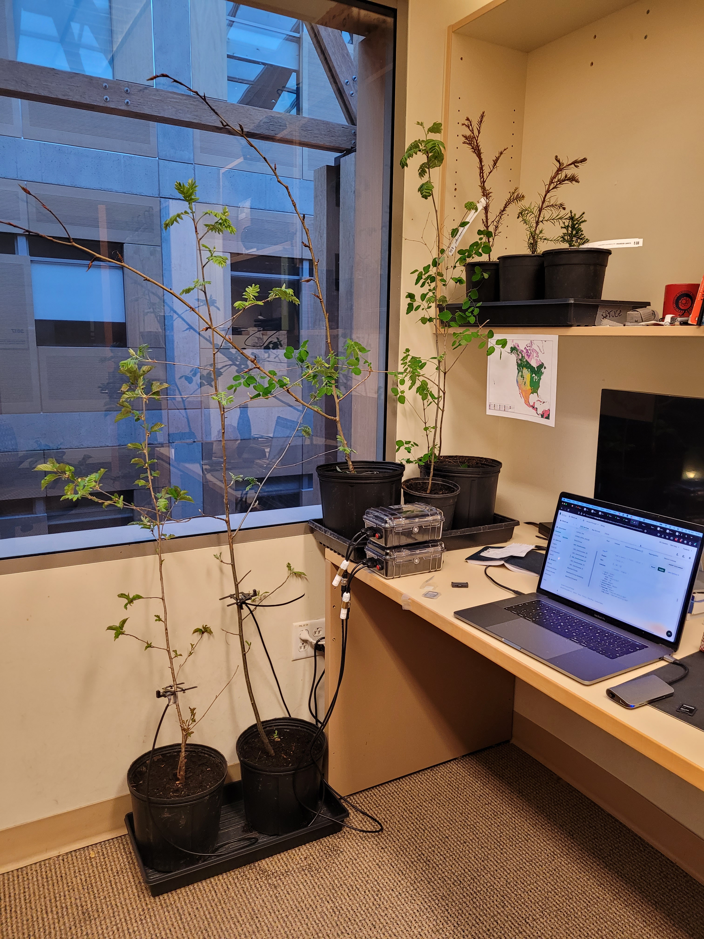
Drought Treatments

Slide 36
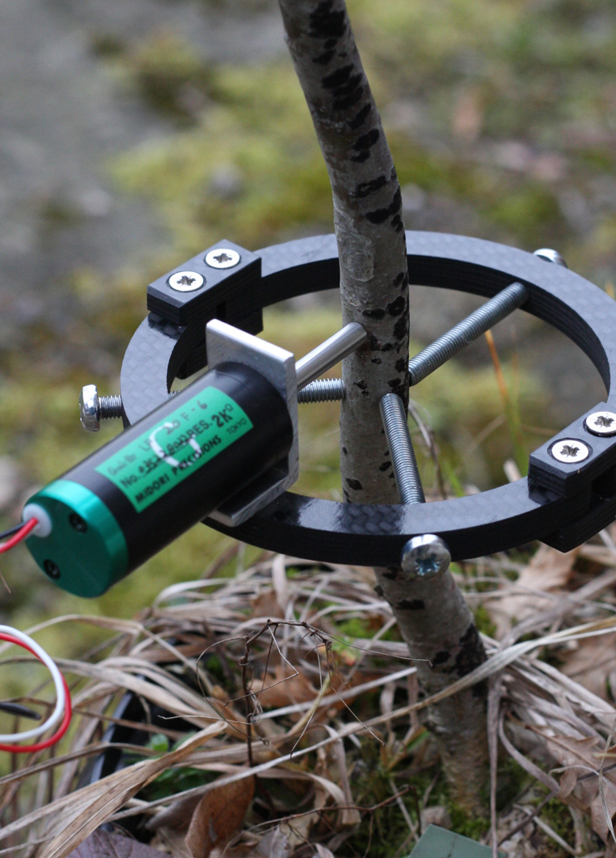
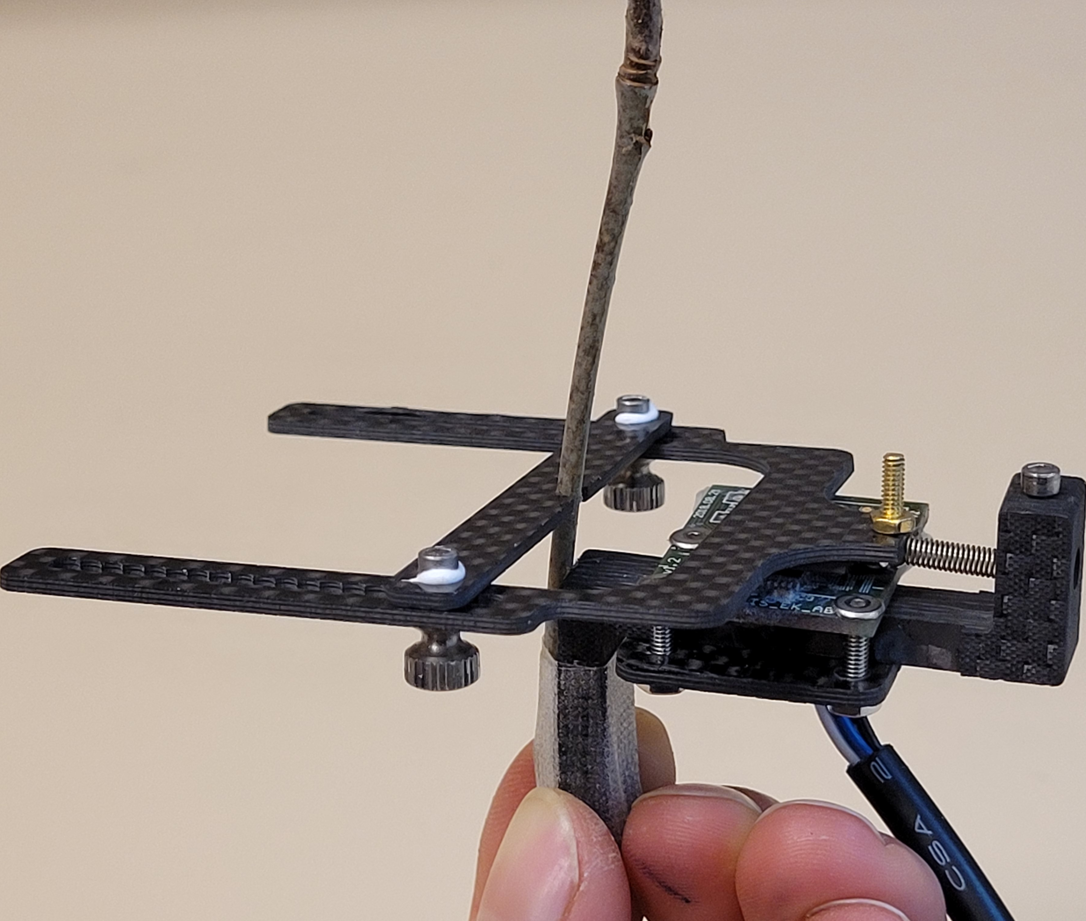
Sensors
Point dendrometer
Magnetic dendrometer
Notes:
And to sense this crucial timepoint trees have only two indicators: Temperature and PP
But altough there are only these 2 main drivers it is rahter complex to understand and predict this phenological event.
After the growing seson a trees undergoes different stages
These three main drivers may interact also in time and surely across species
After release of Endodormancy, Photoperiod and Forcing temperature are the main drivers for leaf-out
Cold temperatures (Chilling)
Warm temperature (Forcing)

Slide 37
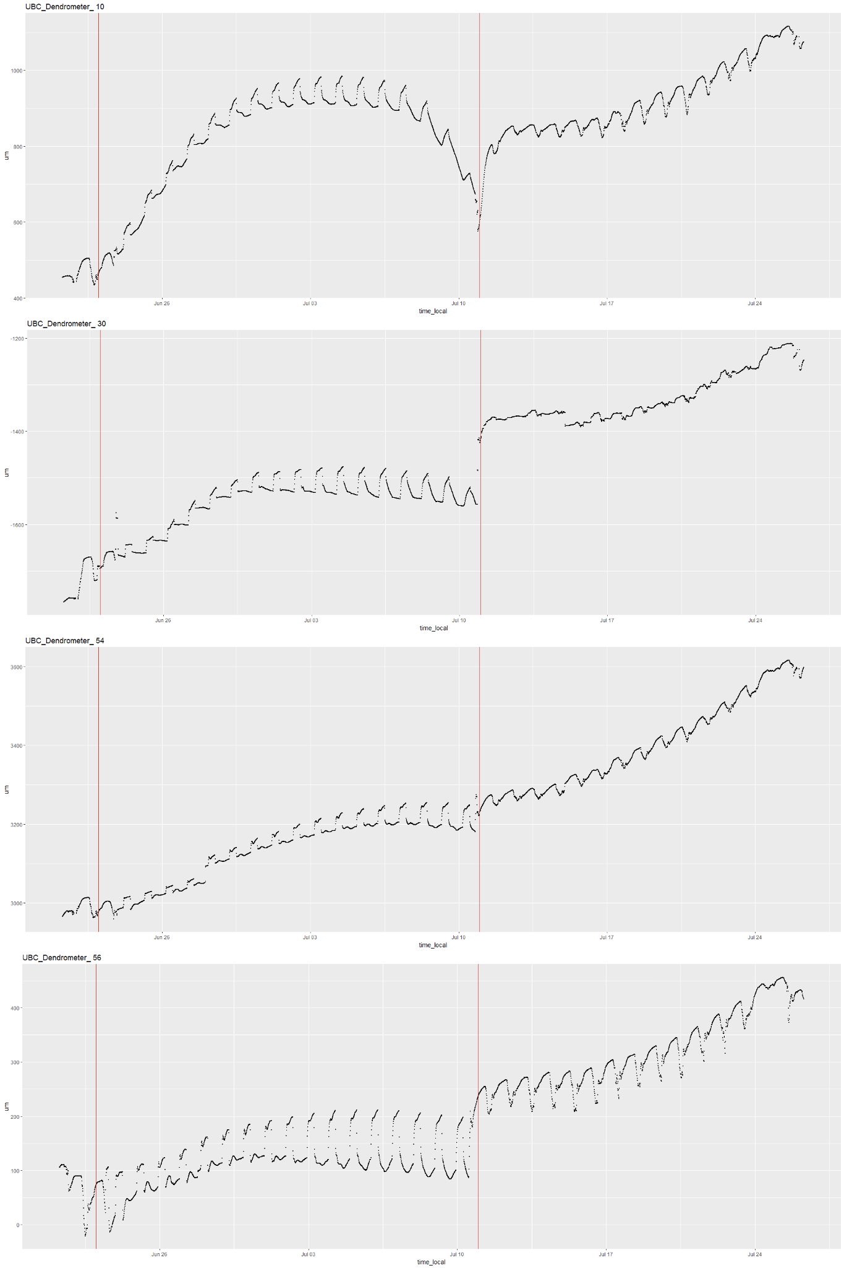
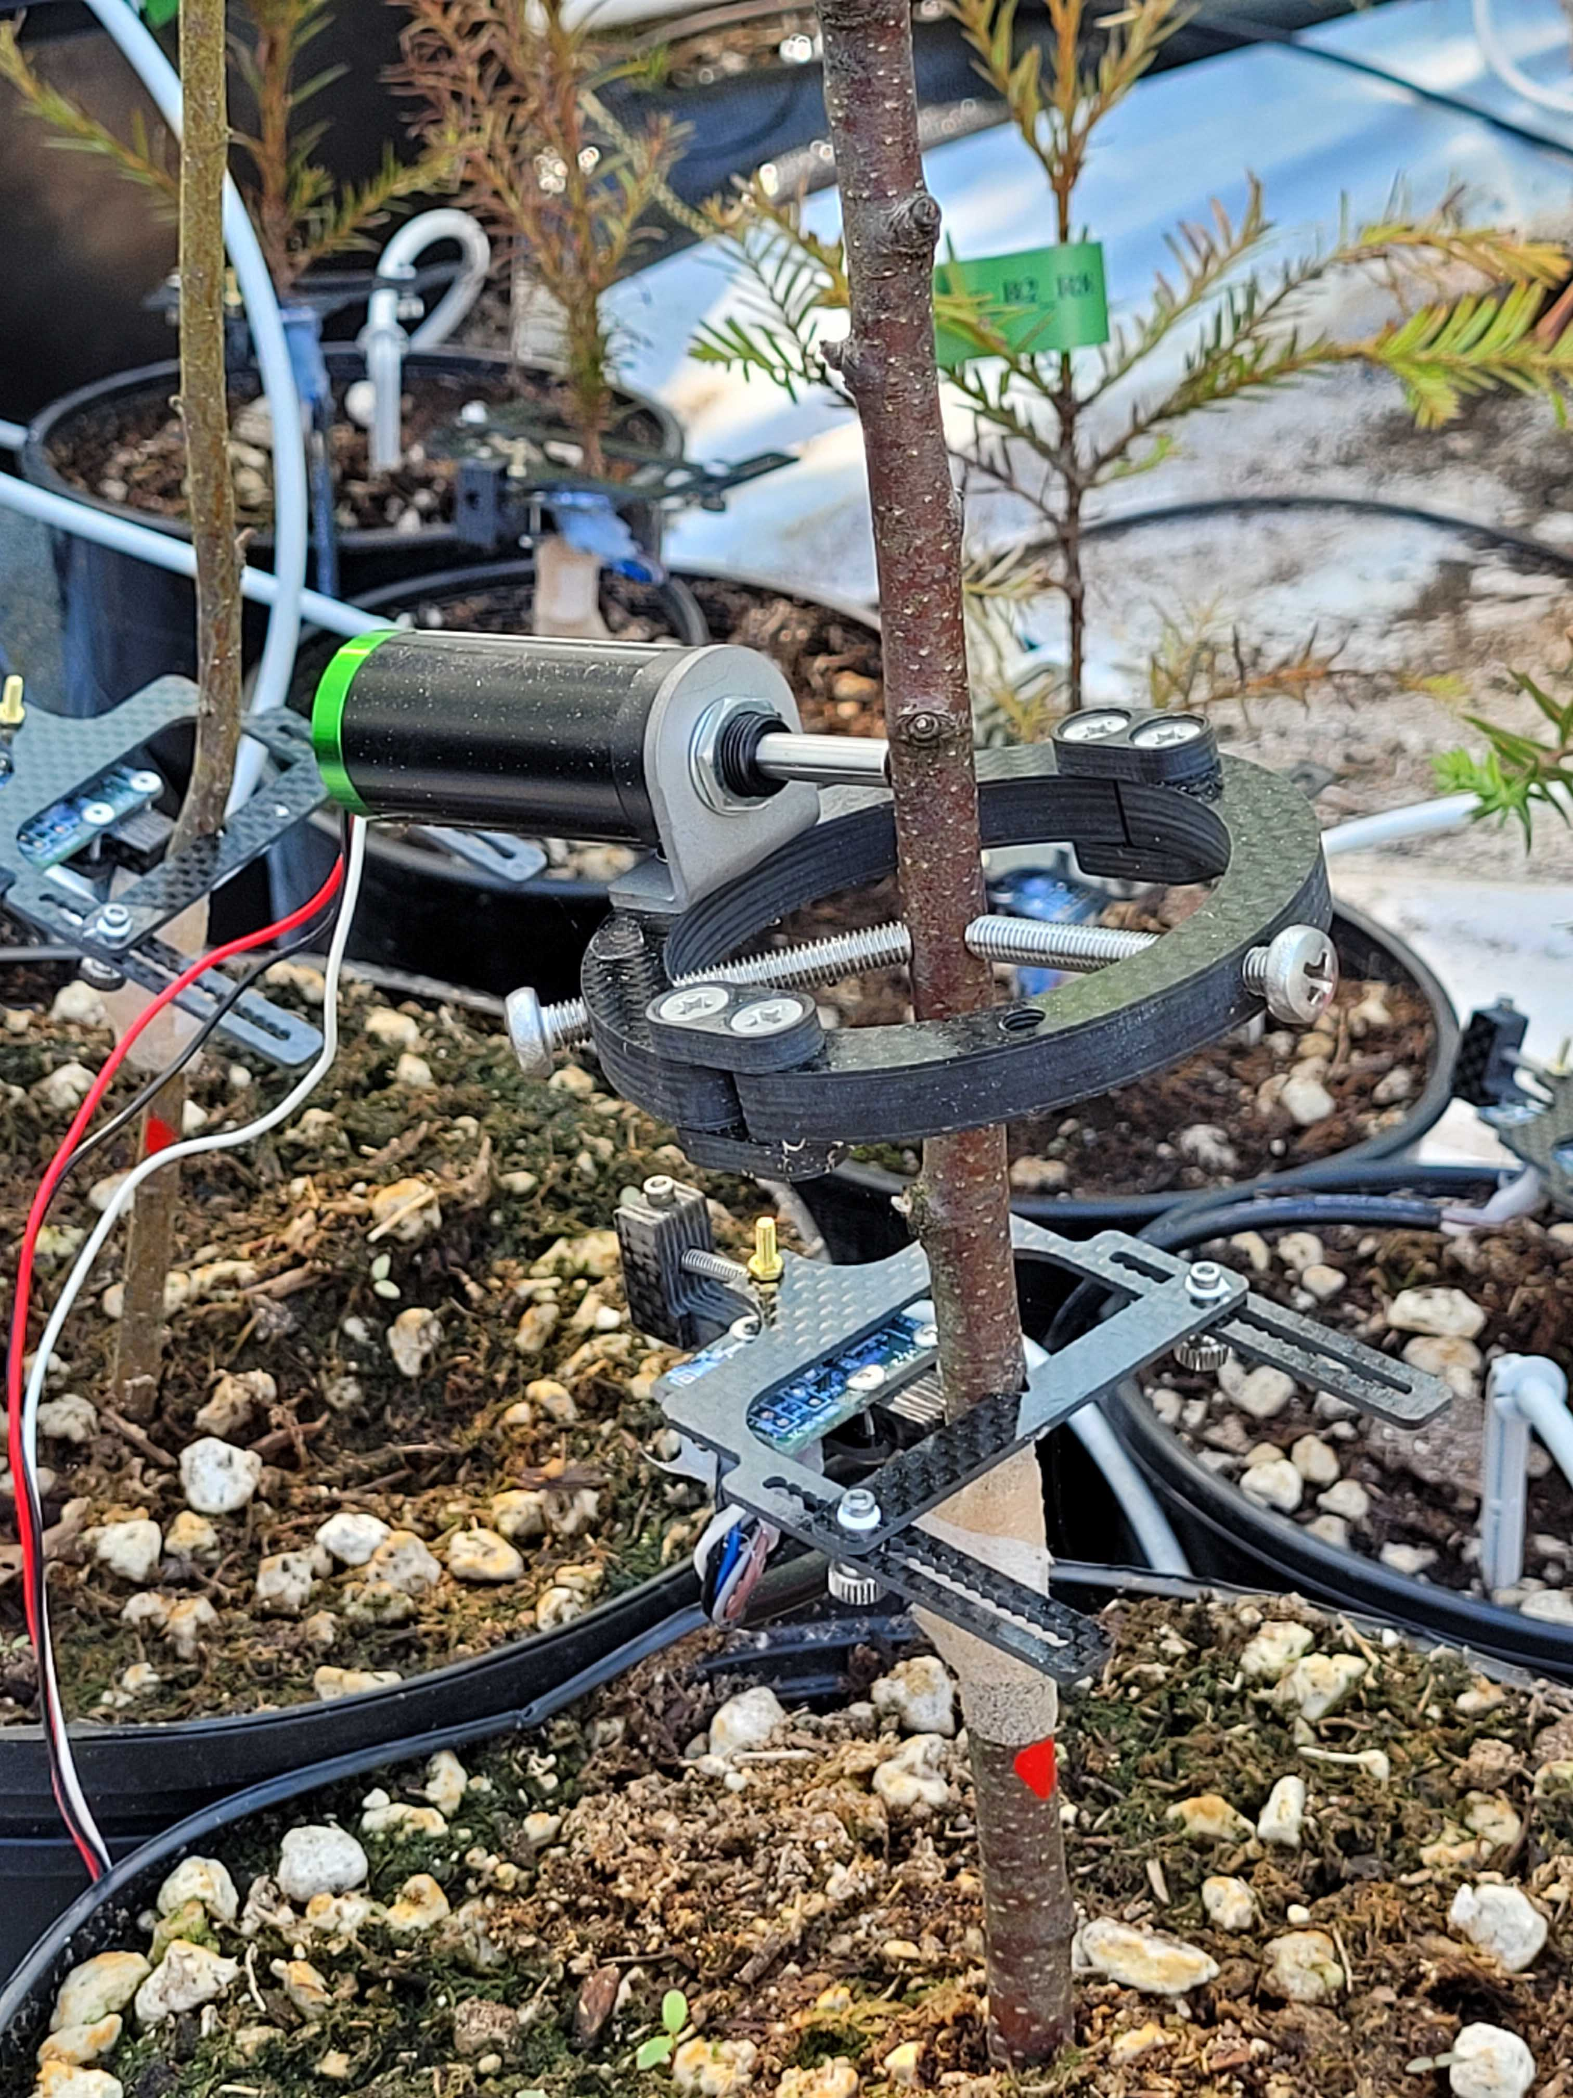
Notes:
I am still not sure what would be the best way to analyse this

Slide 38
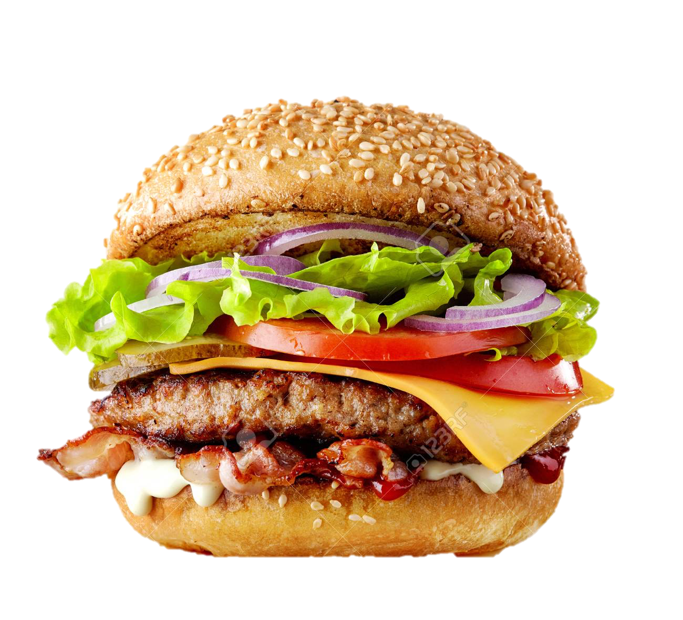
Grow big or develop fast

Slide 39
Growing or Maturing
Biomass
‘normal’ conditions
‘improved’ conditions
Time

Slide 40
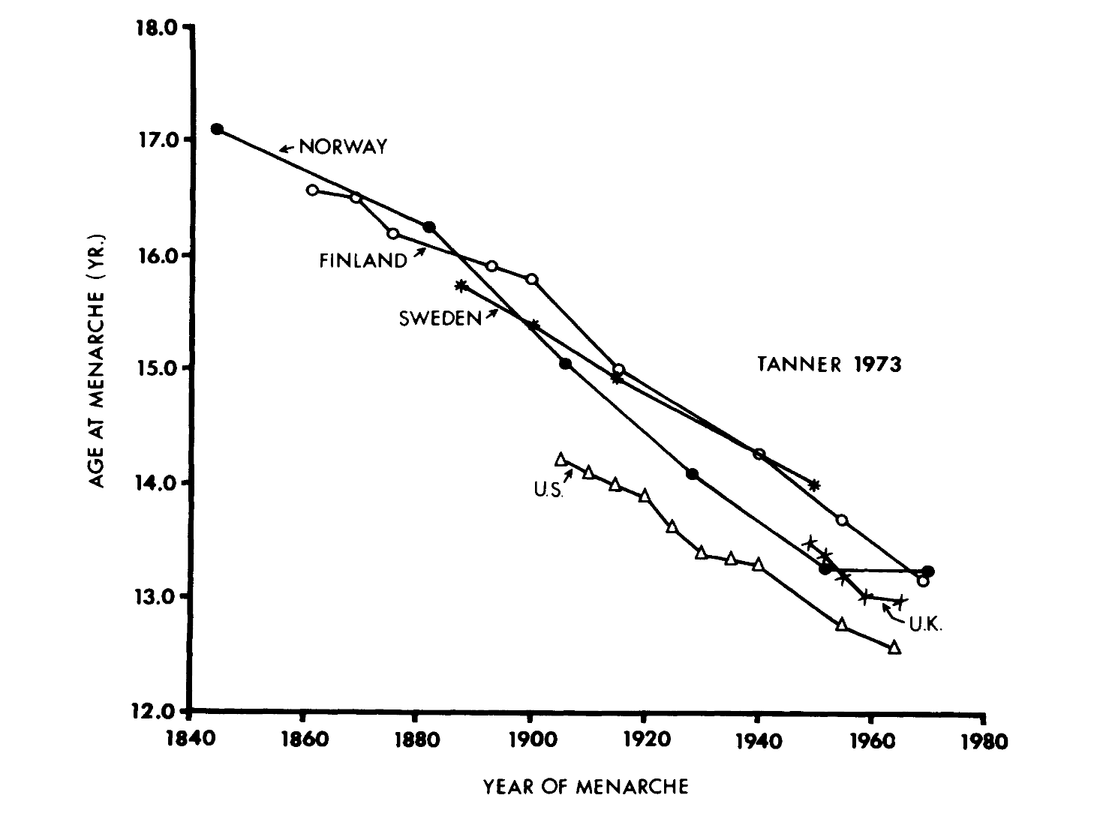
Secular Trend in Humans
Tanner (1973), Nature

Slide 41
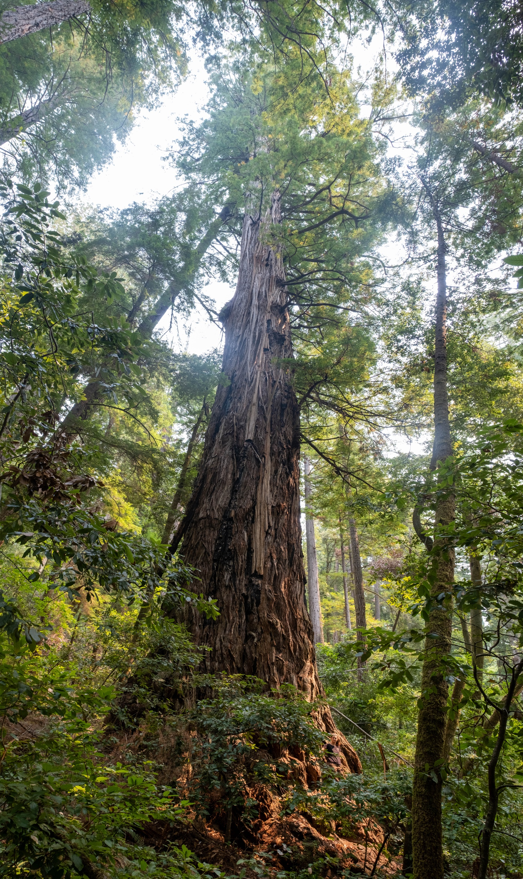
Limits to Tree Height
Tall Trees Grove,
Redwood National and State Parks
Notes:
Aim:
Good to connect

Slide 42
Limits to Tree Height
NSC
Tree height
Stomatal Conductance
Water Potential
Photosynthesis
Shoot elongation
Tall Trees Grove,
Redwood National and State Parks
Notes:
Source and sink activities both decline but there is still an excess of assimilates that are seen in reserve accumulation

Slide 43
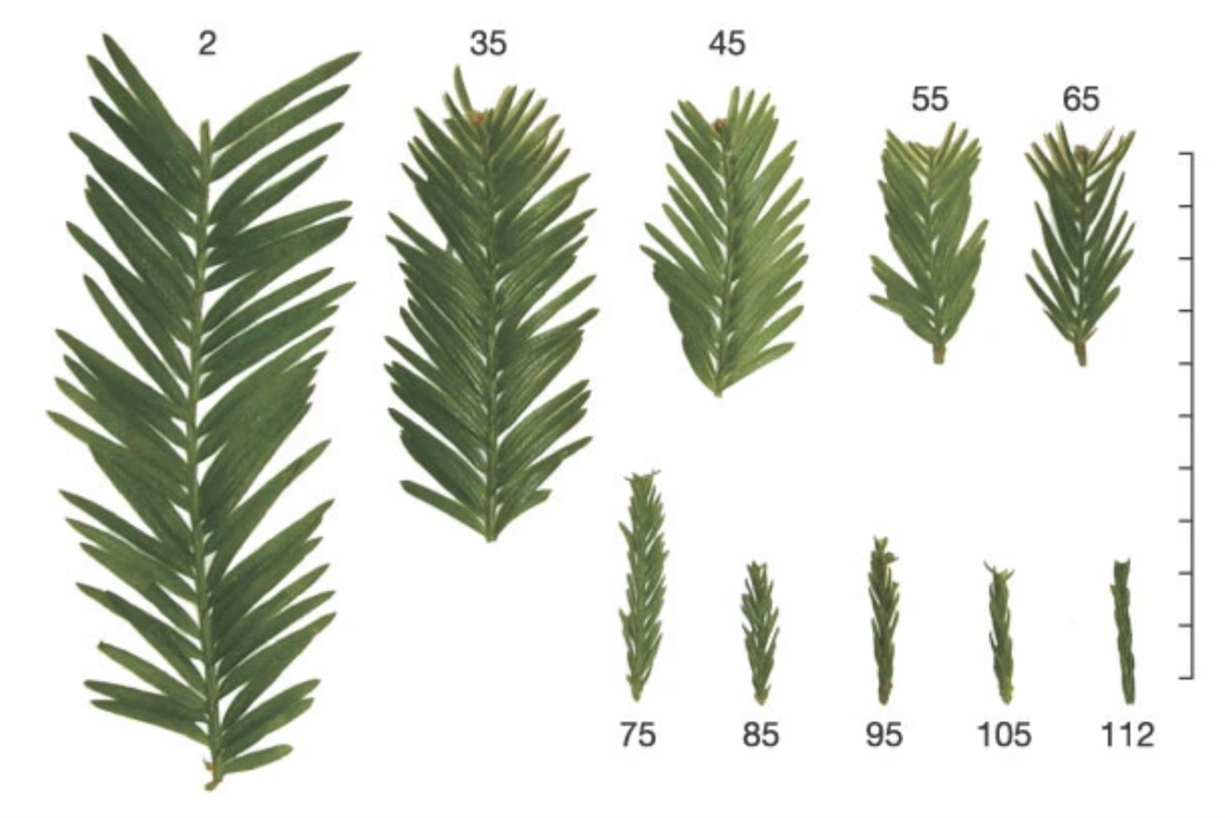
Koch et al. (2003): The limits to tree height, Nature

Slide 44
Species range distribution: Temperature and drought controlled
Hyp.: Limited by number of days within the potential growing season that allow for growth (e.g. XX days with Temp_{Air} >5°C or WP_{Soil}>-0.5 MPa).
Questions:
How flexible are species in shifting their phenology/growth patterns within the growing season?
When is growth and survival most affected? -> Estimate Minimal time of the life cycle/pheno cycle.
Does this time window (and number of days involved) match the time window set by the environmental enveloppe at a species‘ range limit?
2 Approaches
Experiment with saplings
Plausibility check at natural drought controled distribution edges

Slide 45
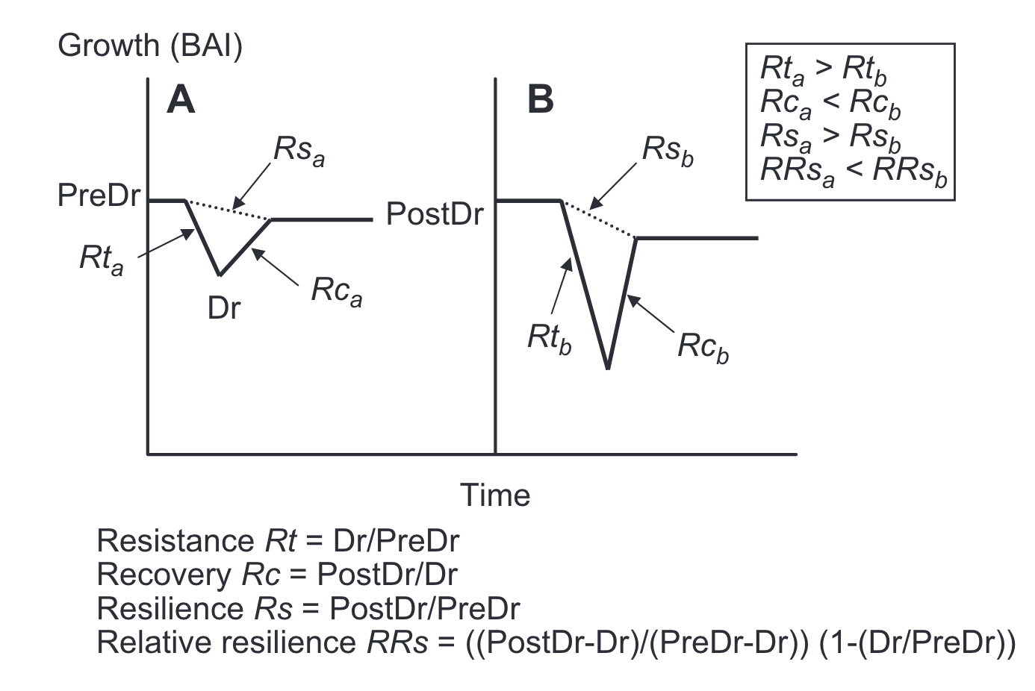
Lloret et al. (2011) Oikos

Slide 46
Resistance, Recovery & Resilience
Pre-Stress
Post-Stress
Growth (BAI)
Stress
Time
after Lloret et al. (2011) Oikos

Slide 47
Resistance, Recovery & Resilience
Pre-Stress
Resilience, Rs
Post-Stress
Resistance, Rt
Resistance Rt = Stress/Pre-Stress
Recovery Rc = Post-Stress/Stress
Resilience Rs = Post-Stress/Pre-Stress
Growth (BAI)
Recovery, Rc
Stress
Time
after Lloret et al. (2011) Oikos

Slide 48
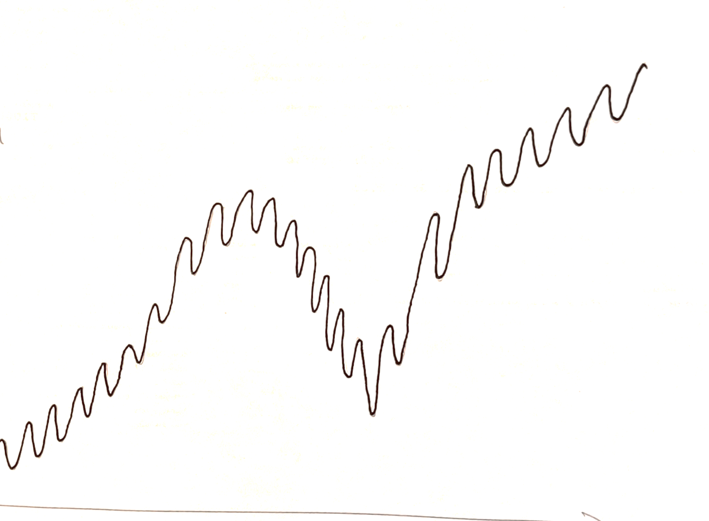
Displacement
Day of year

Slide 49
Post-Drought
Drought
Pre-Drought
Recovery Phase
Displacement
Day of year

Slide 50
Post-Drought
Drought
Pre-Drought
Stress
Phase
Recovery Phase
Stimuli
Phase
Displacement
Day of year

Slide 51
Resilience
Post-Drought
Drought
Pre-Drought
Stress
Phase
Recovery Phase
Stimuli
Phase
Slope Post
Null Hyp: Slope Pre = Slope Post
Hyp1: Resilient/flexible_spec: Slope Post >=Slope Pre
Inflexible spec: Slope Post<Slope Pre
Data: tree ID, daily growth rate, doy, Temp, Pre or Post-Drought
Model: species specific, random factor for treeID
^yi=^B0 + ^B1xi
^yi =^B0 + ^B1 (PreorPost) + ^B2 doy + (1ItreeID)
Displacement
Slope Pre
Resilience = Growth rate Pre drought/Growth rate Post drought
Day of year
Notes:
Measure of flexibility?

Slide 52
Post-Drought
Drought
Pre-Drought
Stress
Phase
Recovery Phase
Stimuli
Phase
Displacement
Resistance = Max during Drough/Min During Drought
Day of year

